Slide 1
Introduction to Information Systems and Programming
Recursion

Slide 2
Recursion
Use recursive method
Recursive method: one that calls itself
Simpler solution to some problems that are difficult to solve using loops

Slide 3
Recursive factorial
n! = 1 if n==0
n! = n x (n-1)! else
public static int factorial(int n) {
if (n==0 )
return 1;
else
return n* factorial(n-1);
}
Base case
Recursive step

Slide 4
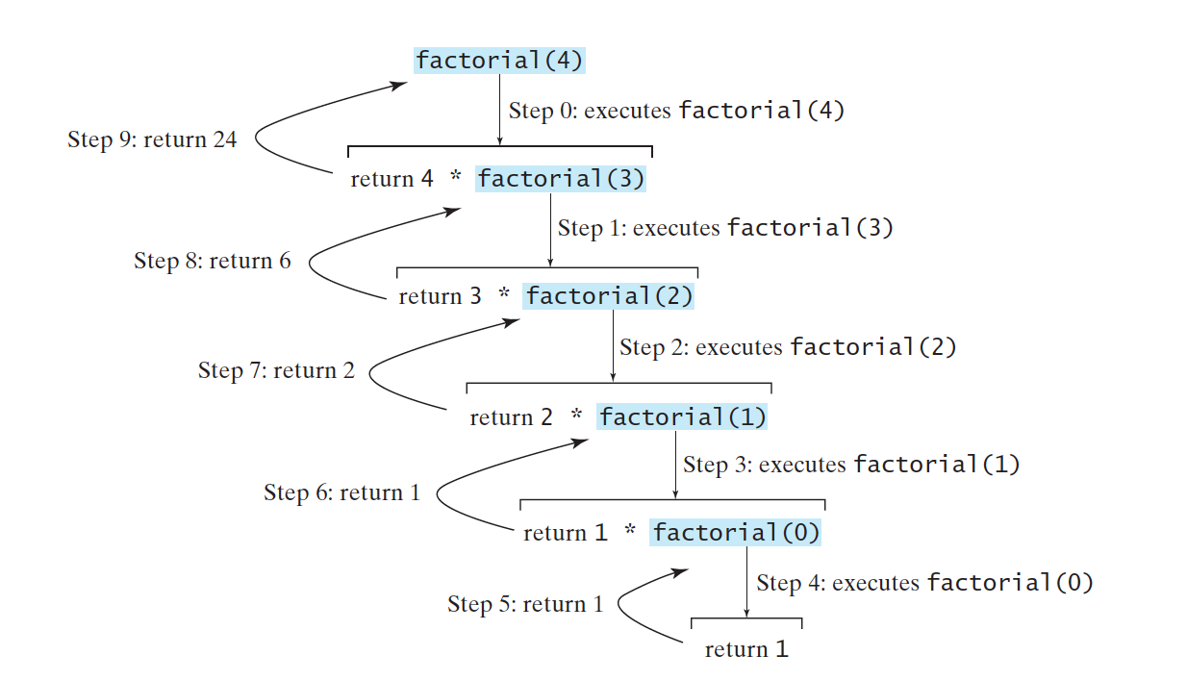
Recursive factorial

Slide 5
Recursion
All recursive methods have:
  Conditional statements such as if-else to select different cases
  One or more base cases (the simplest case) to stop the recursion
  Recursive call to ‘reduce’ the original problem to closer to the base cases

Slide 6
Recursive thinking
To solve a problem using recursion, the key is to identify the sub-problem
Sub-problem: same as original problem but smaller in size
Ask yourself: what is the “size” in your problem?
Recursive step: how to use the sub-problem to solve your original problem?

